Slide 1


Department of Computer Science and Engineering
SYSTEM FOR IDENTIFYING AGGRESSIVE BEHAVIOURS IN PUBLIC PLACES USING CNN MODEL
BHUVANESH KUMAR S [211419104042]
DINESH KUMAR M [211419104069]
DEVESH R [211419104056]
GUIDE:
Dr. N. PUGHAZENDI M.E., Ph.D.
COORDINATOR:
Dr. N. PUGHAZENDI M.E., Ph.D.

Slide 2
Introduction
Violence activity recognition from surveillance video is an active research area of image processing and computer vision.
Through the visual surveillance, human activities can be monitored in sensitive and public areas such as bus stations, railway stations, airports, banks, shopping malls, school and colleges, parking lots, roads, etc. to prevent terrorism, Accidents, fighting and crime.
It is very difficult to watch public places continuously, therefore an intelligent video surveillance is required that can monitor the human activities and categorize them as usual and unusual activities and can generate an alert.

Slide 3
Objective of the Project
• Detection of unusual human behavior in public places has been a tedious process if we do it as manual process.
• As it is a important task, human process may be random and unpredictable and classification of human violence can be very difficult.
• So we are proposed system which works as a Automated Surveillance System to detect and track Violence Activity.
• The primary goal of video surveillance is to replace the current passive version so that aberrant human activity may be recorded and, after analysis, an alert can be generated through alarms to stop odd activity.

Slide 4
Literature Survey
S.NO | AUTHOR & YEAR | TITLE | OBJECTIVE
1. | Ms. U. M. Kamthe, Dr. C. G. Patil (2018) | Suspicious Activity Recognition In Video Surveillance System | This system predicts the suspicious activities using some predefined conditions and eliminates the training of Dataset in machine learning methods main focus on ATM loitering and abandoned luggage.
2. | Suvarna Nandyal, Sanjeev kumar Angadi(2021) | Recognition Of Suspicious Human Activities Using KLT and Kalman Filter For ATM Surveillance System | System which detects the suspicious and non-suspicious behaviors of human in ATMs. uses the Kanade Locus Thomasi algorithm which extracts features and object tracking to detect the suspicious activities this is an real time tracking system.

Slide 5
Literature Survey
S.NO | AUTHOR & YEAR | TITLE | OBJECTIVE
3. | Miwa Takai (2020) | Alert Generation On Detection Of Suspicious Activity Using Transfer Learing | Proposed system provides additional feature to the CCTV camera's by providing a way to detect the suspicious activities like shop lifiting, robbery. By Using CNN model.
4. | Abouzar Ghasemi (2016) | Suspicious Behavior Detection of People by Monitoring Camera | This system propose a new approach based on the processing of the object trajectory for the detection of a suspicious behavior. The trajectory processing relies on the displacement vector of the interest object in

Slide 6
Literature Survey
S.NO | AUTHOR & YEAR | TITLE | OBJECTIVE
5. | Nipunjita Bordoloi, Anjan Kumar Talukdar (2021) | Suspicious Activity Detection from YOLOv3 | YOLOv3 is used to identify a variety of suspicious activities, such as bag theft and lock-breaking. Both the system's processing speed and detection accuracy are very good. Only in a controlled environment does the current feature extraction technology provide correct findings.
6. | Aqil Shamnath, Meena Belwal (2022) | Human Suspicious Activity Detection Using Ensemble Machine Learning Techniques | The decisions made by various models are combined in ensemble machine learning to enhance performance. We can identify suspicious behaviour in public transportation, such as chain stealing and bag stealing, using what we've learned. This technique provides a detection accuracy of 88%.

Slide 7
Problem Statement
Most countries are implementing accurate anomaly detection systems as a means of advancing towards a secure environment due to rising crime rates and general human insecurity worldwide.
To identify suspicious human activities in surveillance videos: Robbery, Fight and fire etc. from images, videos and CCTV by using deep learning algorithms.
To develop Graphical User Interface or a smart phone friendly application.
To enhances the security of the society by predicting the unusual scenarios and reduce human efforts.

Slide 8
Proposed System
• In our project, we have decided to overcome the drawbacks of the existing systems by using Sequential Model.
• By using sequential model we are able to extract the features from the Data frames like,
➢High resolution data
➢various variety of illumination in the data
➢large no of perspectives in the data
• The above data constraints are used to extract the feature and train the model using deep learning model and detect the violence and then alerting the respective authority regarding the activity.

Slide 9
Software / Hardware used
• Software requirements
➢ Python
➢ Jupyter Notebook (Worksapce)
➢ Keras-Tensorflow(Deep learning Library)
➢ Pyttsx3 – for Voice Generation
➢ OpenCV– library for Capturing video.
Hardware requirements
RAM : 8GB
Processor : AMD Ryzen 5k series with NVIDIA-GTX 4GB graphics.
Cameras

Slide 10
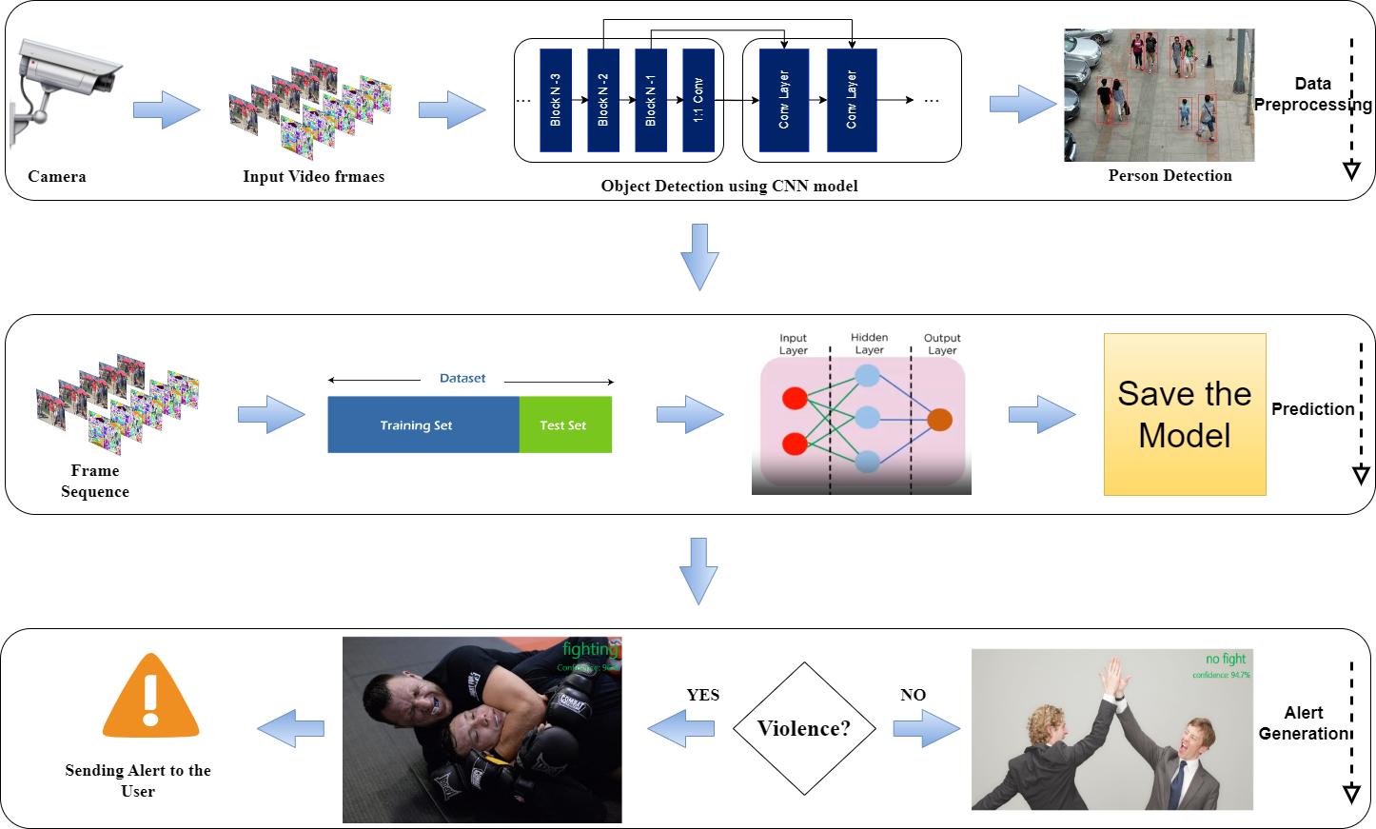
Architecture / Methodology used

Slide 11
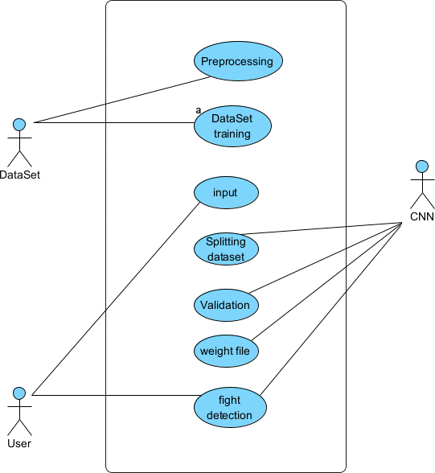
System Design-Use Case Diagram

Slide 12
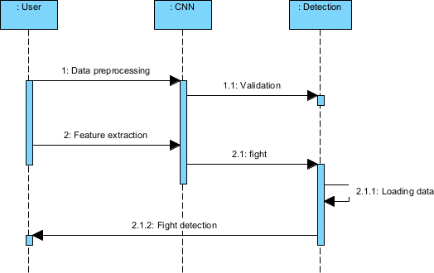
System Design –Sequence Diagram

Slide 13
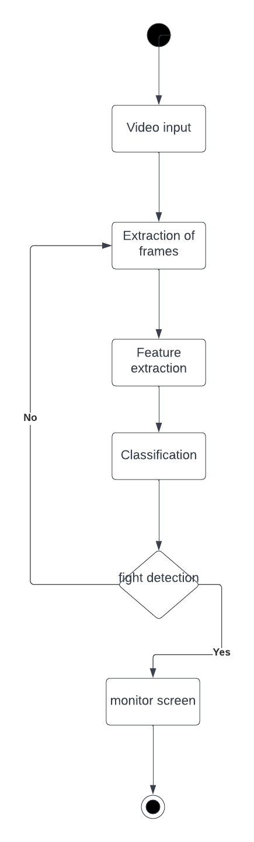
System Design –Activity Diagram

Slide 14
Module Description
The system is made up of three main parts:
Dataset Collection and Preprocessing
Model Training
Prediction of Output

Slide 15
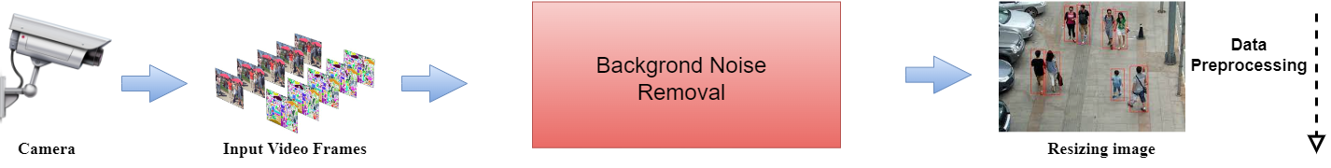
Module Description
Module 1: Data Collection and Preprocessing
The module needs gathering pertinent photos and videos of collisions from a variety of sources, including dashcams, CCTV cameras, and other sources. To guarantee the model's correctness and dependability, the dataset needs to be substantial, diverse, and balanced.
To detect a fight and any important objects in the picture, such as a gun or knife, the technique entails scaling the photographs and videos.
Data collection and preprocessing are crucial steps in creating a reliable and effective system for detecting violent crimes because the quality of the training data directly affects the model's performance

Slide 16
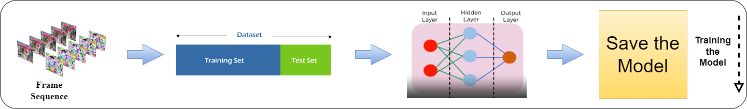
Module Description
Module 2: Model Training
The training data should be varied, extensive, and balanced to guarantee the model's correctness and dependability. A wide range of violence scenarios, lighting circumstances, and other pertinent elements that may affect the model's accuracy should be included in the training data. After the model has been trained, transfer learning strategies can be used to improve it. A limited collection of photos and videos particular to the intended application is used to fine- tune the model, increasing its efficacy and accuracy.

Slide 17
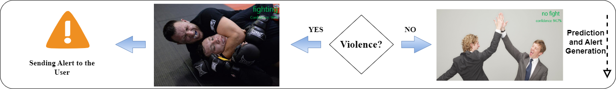
Module Description
Module 3: Prediction of Output
The final stage in creating a reliable and effective violence detection system is the prediction of output module for violence detection using CNN. The module entails applying the trained CNN model to forecast the likelihood of violence and any pertinent scene elements, such as a knife or gun. Preprocessed data, including photos and videos, must be input into the trained model in order to forecast the output module.

Slide 18
Testing /Performance Evaluation / Results
TEST REPORT : 01
USE CASE : Upload Input Video
TEST CASE ID | ACTION TO BE PERFORMED | EXPECTED RESULT | ACTUAL RESULT | PASS/FAIL
1 | Upload the Video frames of .mp4 as input | Uploaded | Uploaded | Pass
2 | Upload the Video frames of .avi as input | File format must be changed and uploaded | Supported | Pass

Slide 19
Testing /Performance Evaluation / Results
TEST REPORT : 02
USECASE : Search and Detect Violence Behaviour
TEST CASE ID | ACTION TO BE PERFORMED | EXPECTED RESULT | ACTUAL RESULT | PASS/FAIL
1 | Detect the Violence Behavior in Day time | Detected Successfully | Detected Successfully | Pass
2 | Detect the Violence Behavior in Night time with Light | Detected Successfully | Detected Successfully | Pass
3 | Detect the Violence Behavior in Night time without light | Detected Successfully | Detected | Pass
4 | Detect the Violence Behavior in Crowded area | Detected Successfully | Detected Successfully | Pass

Slide 20

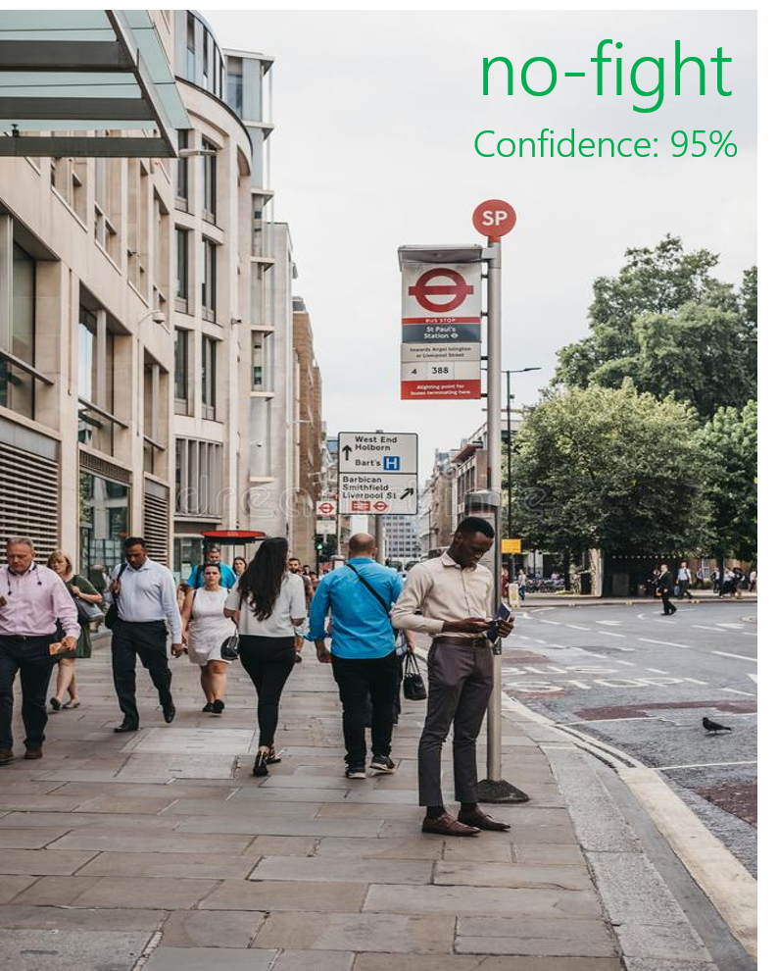

Screen Shots
In these pictures, All the people are doing their own activity and no violence is done there. Hence the machine identifies it as No Fight with a confidence score of above 90%

Slide 21
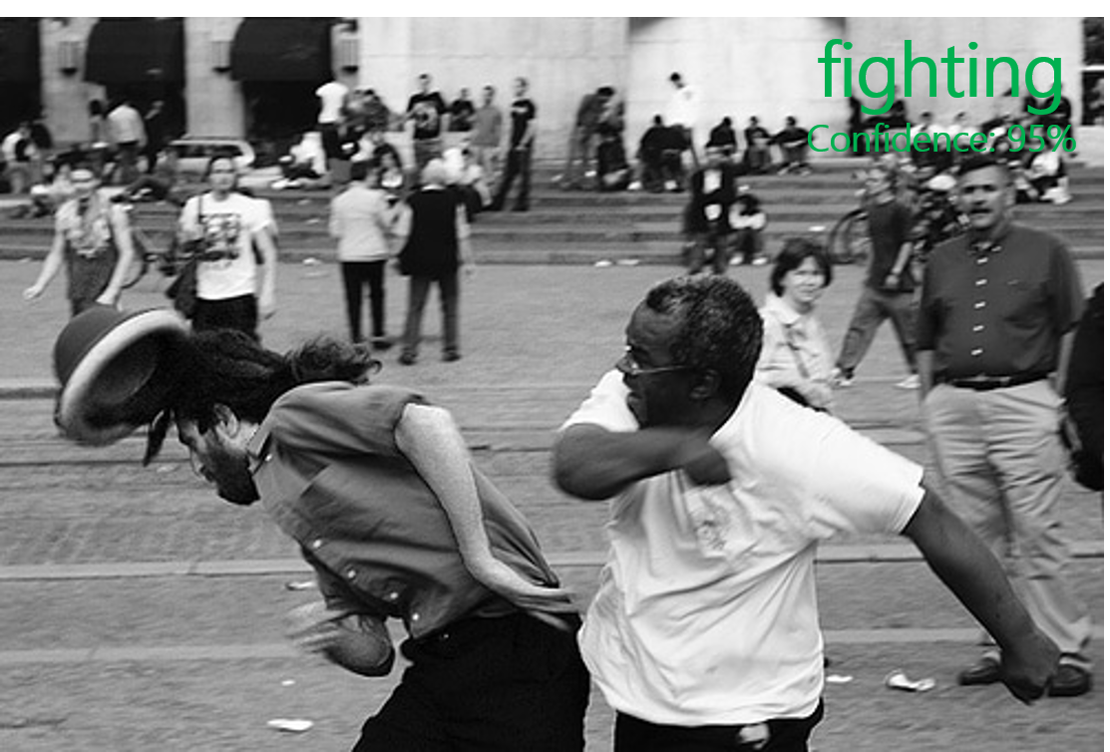
Screen Shots
In this picture, Two men are fighting in a public place. So the machine identifies it as a Fight with a confidence score of 95%.

Slide 22
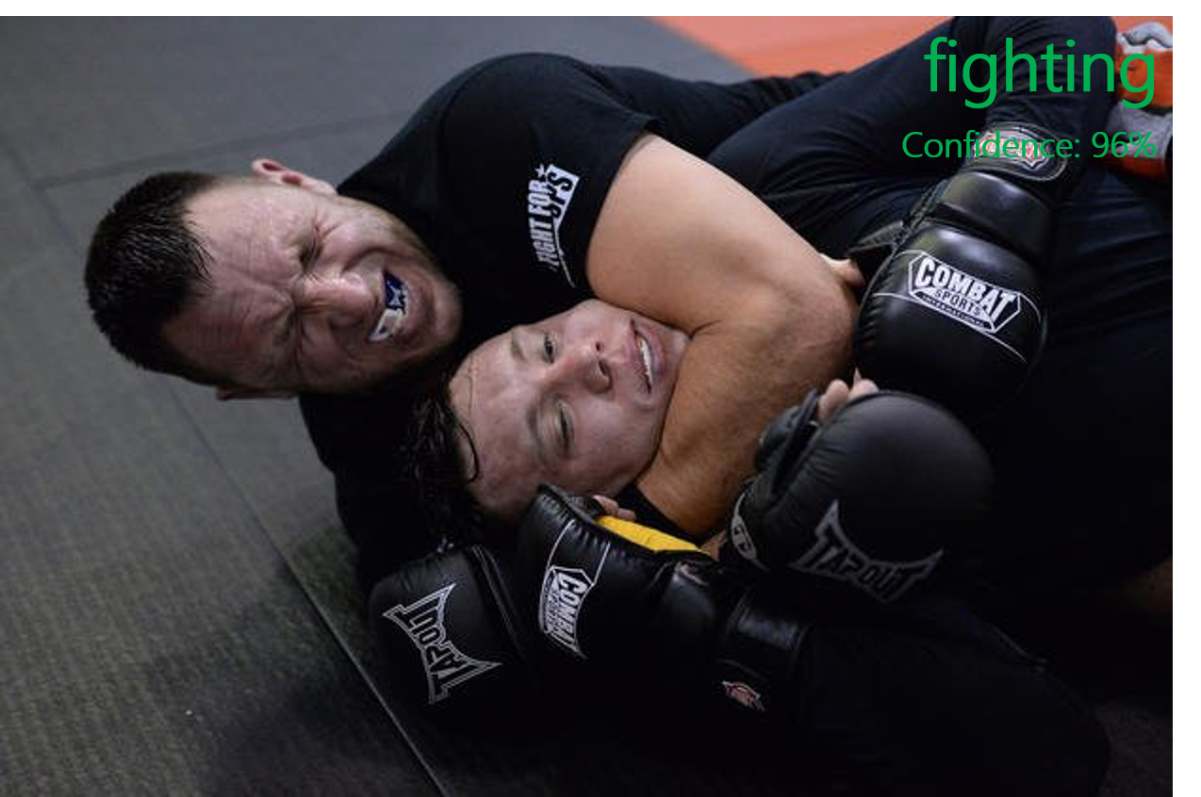
Screen Shots
In this picture , Two men are fighting(which means they are playing combat sports). Hence the machine identifies it as Fight with a confidence score of 96%.

Slide 23
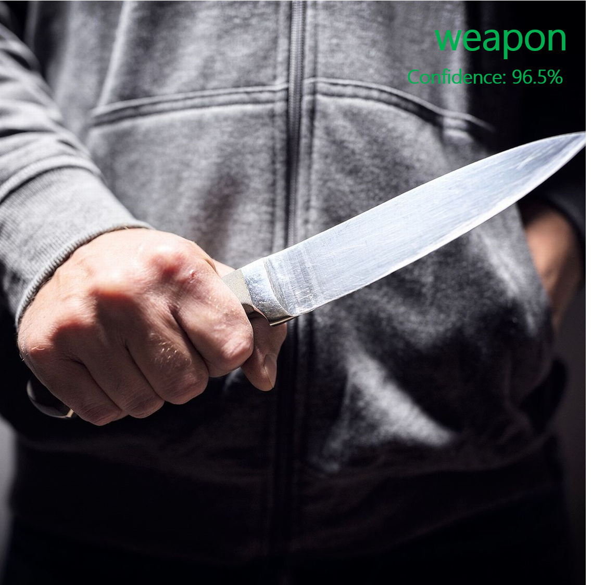
Screen Shots
In this picture, A man was standing with a knife in his hand, So a violence is going to be done. Hence the machine identifies it as weapon with a confidence score of 96.5%.

Slide 24
Conclusion
In the modern world, practically everyone is aware of the value of CCTV footage, yet in the majority of cases, these footages are only used for investigation after a crime or incident has occurred. According to the project, to identify suspicious activity in surveillance footage, convolutional neural networks for feature extraction and discriminative deep belief networks for action categorization should be used.
The suggested approach provides better categorization than past attempts by utilizing a deep-learning-based model. Then, using CNN, we extracted characteristics from the background and foreground of the movie after dividing it into frame segments.
A trained DDBN then receives the output and organizes the recognized actions as normal or suspicious. More precision and fewer false positives are promised by the deep learning model.

Slide 25
Future Enhancement
In the future, the model can be improved by developing more interactive and data visualization tools that help future investigators quickly identify suspicious activities. The focus on the user interface experience for the end users can be enhanced. The introduction and utilization of blockchain technology to the model can produce secure and safe data related to abnormal or suspicious activities which can provide greater transparency and accountability, as well as improve data integrity and privacy.

Slide 26
Reference Paper/ URL
https://ieeexplore.ieee.org/document/9827996

Slide 27
REFERENCES
[1] Ms. U. M. Kamthe and Dr. C. G. Patil “Suspicious Activity Recognition in Video Surveillance System”, Fourth International Conference on Computing Communication Control and Automation, Pune, India, Aug. 2018, pp. 1–6.
[2] Suvarna Nandyal and Sanjeev kumar Angadi “Recognition of Suspicious Human Activities Using KLT and Kalman Filter For ATM Surveillance System”, in International Conference on Innovative Practices in Technology and Management, Noida, India, Feb. 2021, pp. 174–179.
[3] Miwa Takai “Alert Generation on Detection of Suspicious Activity Using Transfer Learning”, in Second World Congress on Nature and Biologically Inspired Computing, Kitakyushu, Japan, Dec. 2010, pp. 298–304.
[4] Abouzar Ghasemi “Suspicious Behavior Detection of People by Monitoring Camera”, 2016. International Journal of Computer Trends and Technology (IJCTT) – volume 29 Number 1.

Slide 28
REFERENCES
[5] Nipunjita Bordoloi, Anjan Kumar Talukdar “Suspicious Activity Detection from YOLOv3”, 2021.IEEE 10.1109/INDICON49873.2020.9342230.
[6] Aqil Shamnath and Meena Belwal “Human Suspicious Activity Detection Using Ensemble Machine Learning Techniques”, 2022. IEEE 10.1109/CONIT55038.2022.9848183.
[7] Sathyajit Loganathan and Gayashan Kariyawasam “Suspicious Activity Detection in Surveillance Footage”, in International Conference on Electrical and Computing Technologies and Applications, Ras Al Khaimah, United Arab Emirates, Nov. 2019, pp. 1–4.
[8] Amrutha C. V and Joytsna Amudha J “Deep Learning Approach for Suspicious Activity Detection from Surveillance Video”, 2020.IEEE ICIMIA48430.2020.9074920.

Slide 29
THANK YOU

